Slide 1
The Training Benefits Program – A Methodological Exposition
To: The Research Coordination Committee By: Jonathan Adam Lind Date: 04/01/16

Slide 2
Agenda
1) A brief overview of the Training Benefits (TB) program.
2) A quick glance at the raw data assessing the effects of TB program participation on earnings.
3) The nature of these data – a quick introduction to panel data.
4) A juxtaposition of two methodological strategies (Difference in Differences and the “within transformation”) capable of controlling for individual-level “fixed effects”.

Slide 3
Training Benefits (TB) Program Overview
The Training Benefits (TB) Program was established by the Washington State Legislature in 2000.
The goal of the program is to retrain unemployed individuals who qualify for unemployment benefits but whose skills are no longer in demand.
Approximately 1,650 individuals were approved for the TB program in fiscal year 2015.
TB participants are drawn from a broad spectrum of the overall UI population, but tend to be more female, more urban, and slightly more educated than the general UI population.

Slide 4
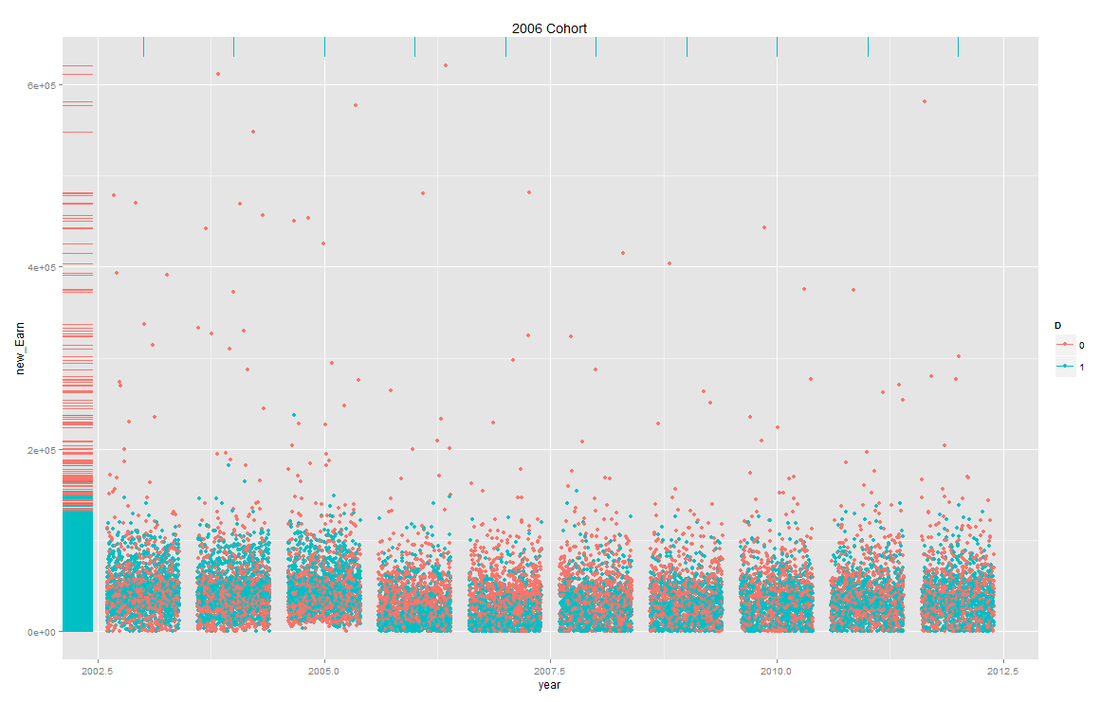
The Raw Data – TB Participation and Earnings

Slide 5
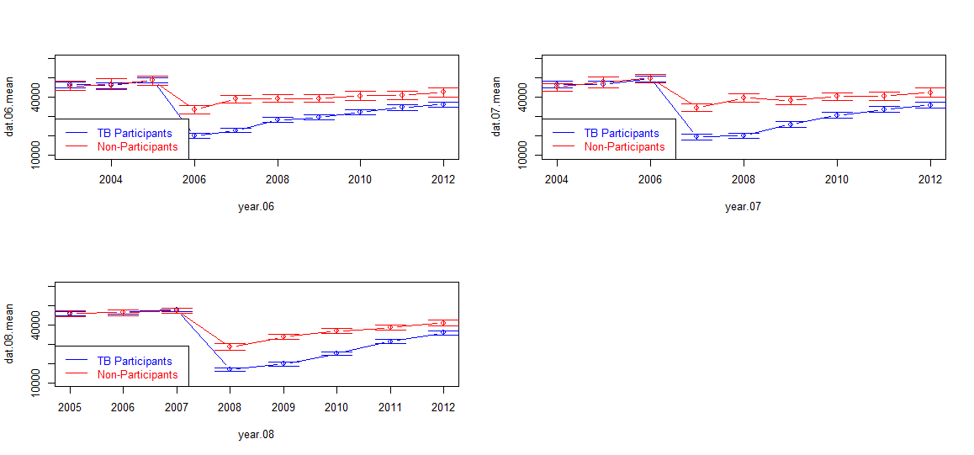
An Abstraction of the Raw Data – TB Participation and Earnings

Slide 6
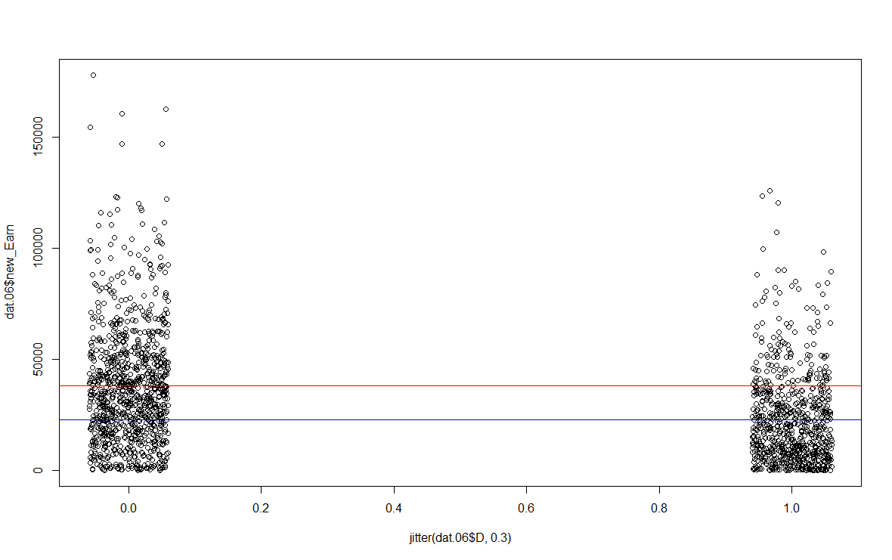
A Bivariate OLS Regression of Earnings on TB Participation

Slide 7
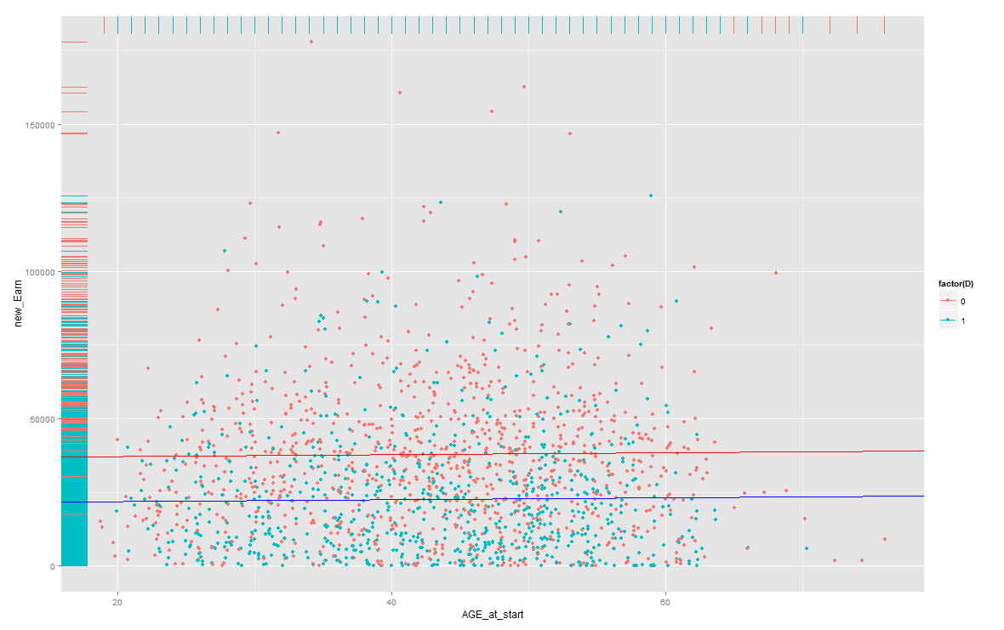
A Multivariate OLS Regression of Earnings on TB Participation and Age

Slide 8
Omitted Variable Bias – The Achilles Heel of Methods Such as OLS
The classical linear regression model (OLS) assumes that the error term (u) is 1) unrelated to the dependent variable and 2) uncorrelated with any of the explanatory variables.
$$Y= β_{0}+ β_{1}X+u$$
This is, of course, a rather restrictive assumption in that it requires us to include everything in our model that is correlated with any dependent or explanatory variable.
This is fine if we have measures of all the factors that may be correlated with both earnings and all other explanatory variables and there are indeed many things we can (and do!) measure that fit this criteria.
For example, we have measures of age, gender, ethnicity, occupation… many others.
But… we can’t measure everything. Indeed, some things that may be related to earnings that we simply cannot measure.
For example, it would be difficult to measure things like motivation, or “people skills” – yet we still might expect these things to be associated with earnings.
These sorts of unmeasurable concepts are often referred to as “unobserved heterogeneity”.

Slide 9
One way to mitigate the effects of omitted variable bias - Panel Data
One distinguishing feature of our data presented is that it “follows” individuals as they progress through time.
Such a structure, of course, allows us to describe change over time – but panel data allows us to do much more than simple description.
One of the key benefits of panel data is that it allows us to use methods that can help to mitigate the effects of omitted variable bias.
Panel data allows us to use methods that can better account for unobserved heterogeneity – as long as the unobserved factors correlated with X do not change, at the individual level, over time.

Slide 10
Difference in Differences (DID)
Often used to assess the effect of a program or policy.
Files for Unemployment
Non-Participant Group
Counterfactual
TB Participant Group
Diff in Diff ($\hat{δ}$)
Observed

Slide 11
Difference in Differences (DID)
Mathematically, the Difference in Differences model can be expressed as:
$$\hat{δ}=\left({\overline{Y}}_{TB Group, Period II} − {\overline{Y}}_{TB Group, Period I}\right) −\left({\overline{Y}}_{Comparison Group , Period II} − {\overline{Y}}_{Comparison Group, Period I}\right)$$
$\hat{δ}$ can be estimated via linear regression through the following equation:
$Y= β_{0}+ β_{1}Period II+ β_{2}TB+ \hat{δ}\left(Period II∗TB\right)+u$

Slide 12
Difference in Differences (DID)
A major advantage of the difference in difference strategy is that it allows us to control for factors that:
Vary across individuals (or other units of analysis), but do not vary over time.
Could cause omitted variable bias if omitted from the regression analysis.
Are unobserved (or even unobservable), and therefore cannot be included in the regression.
The key idea is that if an omitted variable does not change over time, then any changes in Y over time cannot be caused by the omitted variable.

Slide 13
Difference in Differences (DID)
However, one potential disadvantage of the difference in differences strategy is that it assumes that the outcome in the treatment and control group would follow the same time trend in the absence of treatment (The Parallel Trend Assumption).
Unfortunately, to my knowledge, there is no formal method to assess whether the parallel trend assumption actually holds – the best we can do is to examine pre-treatment trends for similarity.
That said, one way we can “impose” parallel trends on the data is to use a matching algorithm (such as propensity score matching) to pair similar treatment, and control group, members.

Slide 14
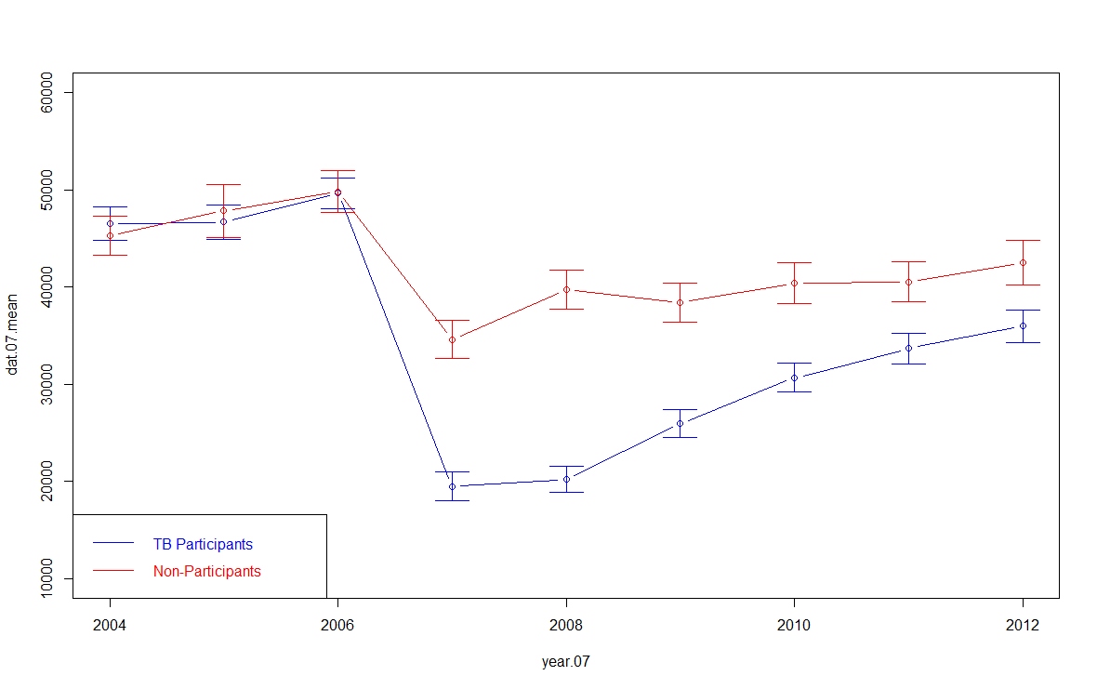
The Parallel Trends Assumption

Slide 15
The Fixed Effects Model (AKA the “within” estimator)
An alternative method to DID (and the method we used in a supplementary analysis to the TB net impact study) avoids potential problems with the parallel trends assumption via a transformation that time-demeans the data.
Part of this transformation involves a composite error term.
e = a_{i} + u_{it}
Where a_{i} represents all time-invariant unobserved factors, and u_{it} represents stochastic error.

Slide 16
The Fixed Effects Model (AKA the “within” estimator)
$y_{it}= β_{0}+β_{1}x_{it1}+ …+ β_{k}x_{itk}+ a_{i}+ u_{it}$ (1)
${\overline{y}}_{i}$ = $β_{0}+ β_{1}{\overline{x}}_{i}+ …+ β_{k}{\overline{x}}_{ik}+ a_{i}+ {\overline{u}}_{i}$ (2)
$\left(y_{it} − {\overline{y}}_{i}\right)= β_{1}\left(x_{it1} − {\overline{x}}_{i}\right)+ …+ β_{k}\left(x_{itk} − {\overline{x}}_{ik}\right)+\left(u_{it} − {\overline{u}}_{i}\right)$ (3)
${\ddot{y}}_{it}= β_{1}{\ddot{x}}_{it1}+ … + β_{k}{\ddot{x}}_{itk}+ {\ddot{u}}_{it}$ (4)
Again, the key idea is that any change in (y) cannot be caused by (a) because (a) does not change between time periods (t), (even though it may be correlated with the x’s).

Slide 17
The Fixed Effects Model (AKA the “within” estimator)
Advantages and disadvantages of the within transformation vis a vis DID.
Advantage: Nets out the effect of time-invariant un-observables without having to worry about the perils of the parallel trend assumption.
Disadvantage: Time-invariant observed variables also fall out of the equation (the mean of a constant is the constant)…
… however, time-invariant observed variables may be interacted with the treatment flag to produce estimates of the effect of treatment on different sub-sets of the sample. (Advantage!).

Slide 18
How the within transformation can help us shed new light on differential effects of the TB Program.
We interacted program participation on a number of time-invariant measures such as gender, low-income status, race/ethnicity, and U.S. veteran status to assess whether the effects of TB participation vary by sub-group.
We found evidence suggesting certain sub-groups (e.g. low-income persons, persons pursuing a health-intensive course of study) disproportionately benefited from TB participation…
… and other sub-groups (e.g. persons entering the program during the Great Recession) did not benefit as much from TB participation.

Slide 19
Next steps
We want to continue to do exploratory work using methods such as the within transformation (and other variants of the “fixed effects” class of models) to expand our methodological toolkit and help us better assess a broader array of research questions.
In particular, we want to go back to the data used in the publication Effect of Community and Technical College Course Work… to get a better understanding of how the mix of college credits taken by TB participants affects their earnings outcomes.
We found some evidence that health related courses were associated with better earnings outcomes among TB program participants. We would like to explore this dynamic in fuller detail.
We would also like to more fully explore the effects of TB program participation on different subsets of participants. Which groups do better? Which groups do worse?

Slide 20
In summary
Simpler modelling strategies (such as OLS) can help us better understand some research questions, but they suffer from the problem of omitted variable bias.
How can you control for things you cannot even observe!
Panel data, or data that tracks people over time, can be exploited to get around the limitation.
If something about an individual does not change over-time, then it cannot be responsible for over-time changes in individual-level outcomes… even if that something cannot be observed by the researcher!
ESD has relied heavily on Difference in Differences – which is a suitable model in many cases, but may not be ideal in every case.
The “within” transformation, is an alternative to DID. This method allows us to control for unobserved heterogeneity as well as assess the effect of treatment on different sub-sets of the sample.

